Slide 1
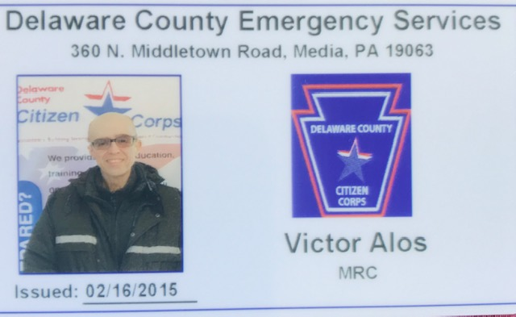
Delco Medical Reserve Corps (MRC)
COVID-19 & Monkeypox Update
July 2022
Victor Alos Rullan, DMD, MPH, MS
Delaware County Health Department (DCHD) Epidemiologist
MRC / CERT

Slide 2
Agenda
COVID-19
What is monkeypox?
2003 US outbreak
Transmission
Treatment
DCHD services

Slide 3
COVID -19

Slide 4
As of July 20,2022, we had a total of 106,076 confirmed COVID-19 cases and 1,907 total deaths since March 28, 2020
On Jan 6, 2022, Delco had a total of 1,826 new daily cases (highest ever)
On 7/19/2022 we had 129 new daily cases
Highest number of daily deaths was on 4/25/2020 with 26, followed by 1/11/2022 with 14 daily deaths
On 7/17/2022 we had 1 death

Slide 5
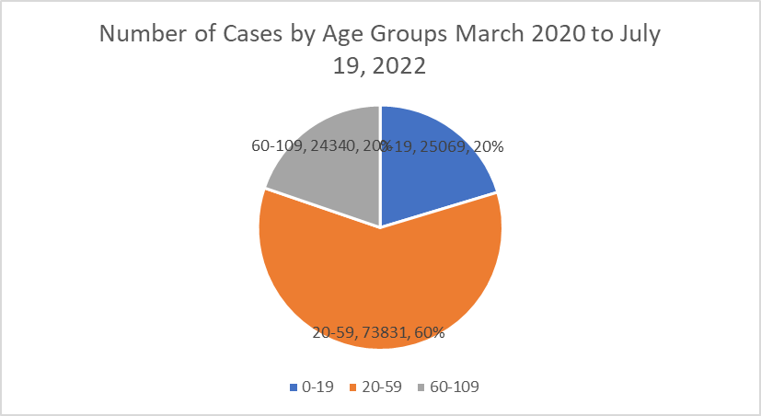
More females than males
African American accounted for 28% of cases and 23.4% of population (2021)
White for 69% of cases and comprised 67% of population (2021)
More cases (25,069 ) in the 0-19 group compared to (24,340) in the 60-109

Slide 6
Largest number of total deaths (541) occurred in the 80 to 89 years of age group, followed by 70 to 79, and 90 to 99

Slide 7
Summary July 20, 2022 (Delaware County)
The total number of new weekly cases decreased by 48 after seeing an increase of 72 cases last week.
Our county experienced in the prior 3 weeks the highest incidence rate of new cases compared to the state and neighboring counties and this week Delco incidence rate is now the 2nd highest, 127 per 100,000, and Philadelphia has the highest at 139.3 per 100,000.
The percent positivity rate remains stable for a second week at 14%.
The average daily number of hospitalized COVID-19 cases (35.7) continues to increase for the second week (30 last week).
The average daily number of COVID-19 cases on ventilators marginally increased from 1.4 to 1.9
After a modest decreasing trend in the percentage of hospital emergency department visits due to COVID-19 like illnesses, for the second week, Delco rate remains stable at 1%
Last week, Delco reported no deaths in 8 consecutive days. This week the county reported one death on July 13, 14, and 17th
On July 7, 2022, Delco CDC COVID-19 Community Level increased from Low to Medium. As of July 20th, 2022, the level remains the same at Medium

Slide 8
Delaware County 7/20/2022
MontCo
Philadelphia Co
Pennsylvania
Chester Co
PA DOH https://www.health.pa.gov/topics/disease/coronavirus/Pages/Monitoring-Dashboard.aspx

Slide 9
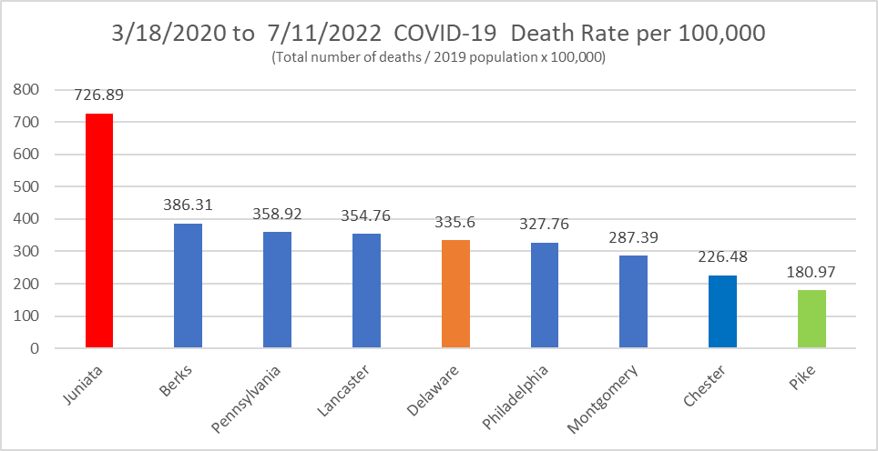
PA DOH https://data.pa.gov/Covid-19/COVID-19-Aggregate-Death-Data-Current-Weekly-Count/fbgu-sqgp

Slide 10
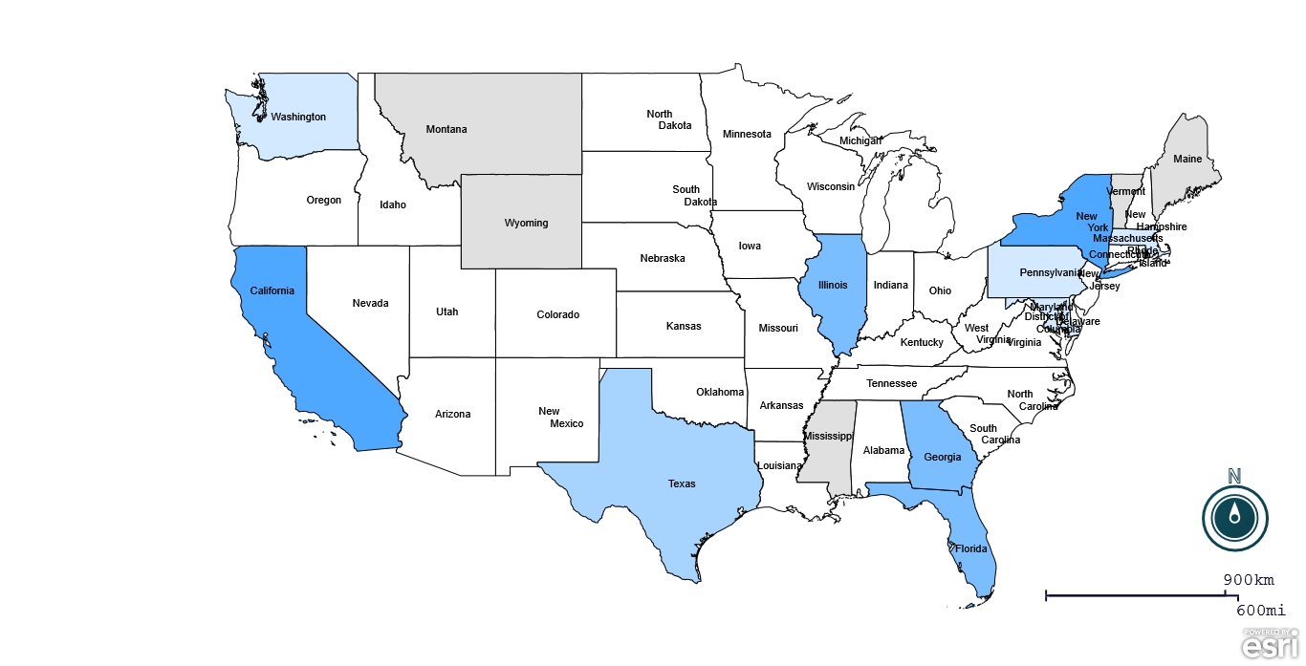
MONKEYPOX
900
55
Map: Epi Info
Data Source: CDC https://www.cdc.gov/poxvirus/monkeypox/response/2022/us-map.html

Slide 11
What is monkeypox?
Monkeypox is a rare disease caused by infection with the monkeypox virus.
Monkeypox virus is part of the same family of viruses as variola virus, the virus that causes smallpox.
Monkeypox symptoms are similar to smallpox symptoms, but milder, and monkeypox is rarely fatal.
Monkeypox is not related to chickenpox.
About Monkeypox | Monkeypox | Poxvirus | CDC

Slide 12
Monkeypox (poxvirus) overview
Human first cases Democratic Republic of Congo (DRC) in 1970
Fever, headache, muscle pains, swollen lymph nodes, and fatigue
Followed by a rash that forms blisters and crusts over
From exposure to onset of symptoms is usually 7 to 14 days
Duration of symptoms is typically two to four weeks
Has been fatal in people with HIV/AIDS but is not typically a cause of serious systemic illness Blindness can occur if the infection involves the eyes
Smallpox vaccination should be protective; vaccination in the US was discontinued in 1971
  Most of the U.S. population is not immunized against poxviruses
Easing of restrictions and rebound in travel and socializing, may have facilitated wider transmission of this virus
Columbia University https://www.publichealth.columbia.edu/public-health-now/news/our-experts-help-explain-monkeypox-outbreak

Slide 13
Monkeypox (poxvirus) overview –cont.
Most cases are in men who have sex with men (MSM)
Lesions can occur on parts of the body, including the genitals or mouth
Recent outbreaks occurred in the context of large gatherings, promiscuity and sex toys contaminated with infectious virus
Smallpox vaccine is very protective against monkeypox, and can prevent disease if given to an exposed (potentially infected) person, even if given within a week or more after infection
Communicating clearly and often regarding the outbreak to providers and the public is key to quickly identify suspected cases and contacts
Meticulous interviewing of cases to identify risk factors and possible sources of infection and getting cases diagnosed as quickly as possible is critical
Recommend to seek care as soon as possible to someone who has travelled from endemic areas, or has had contact with a case who has symptoms of monkey virus infection
Columbia University https://www.publichealth.columbia.edu/public-health-now/news/our-experts-help-explain-monkeypox-outbreak

Slide 14
What caused the 2003 U.S. outbreak?
Shipment of animals (800 small mammals) from Ghana, imported to Texas in April 2003
Infected animals were housed near prairie dogs at the facilities of an Illinois animal vendor. These prairie dogs were sold as pets before they developed signs of infection.
All people infected with monkeypox became ill after having contact with infected pet prairie dogs.
No instances of monkeypox infection were attributed exclusively to person-to-person contact.

Slide 15
How was the 2003 U.S. outbreak contained?
laboratory testing;
deployment of smallpox vaccine and treatments;
development of guidance for patients, healthcare providers, veterinarians, and other animal handlers;
tracking potentially infected animals;
and investigation into possible human cases
restriction on the importation of African rodents

Slide 16
How is the virus transmitted?
Monkeypox can spread from the time symptoms start until the rash has fully healed and a fresh layer of skin has formed.
  The illness typically lasts 2-4 weeks.
  People who do not have monkeypox symptoms cannot spread the virus to others.
  At this time, it is not known if monkeypox can spread through semen or vaginal fluids.
The virus can spread from person-to-person through:
  direct contact with the infectious rash, scabs, or body fluids
  respiratory secretions during prolonged, face-to-face contact, or during intimate physical contact, such as kissing, cuddling, or sex
  touching items (such as clothing or linens) that previously touched the infectious rash or body fluids
  pregnant women can spread the virus to their fetus through the placenta
It’s also possible for people to get monkeypox from infected animals, either by being scratched or bitten by the animal or by preparing or eating meat or using products from an infected animal.
How it Spreads | Monkeypox | Poxvirus | CDC

Slide 17
Prevention
Avoid close, skin-to-skin contact with people who have a rash that looks like monkeypox.
  Do not touch the rash or scabs of a person with monkeypox.
  Do not kiss, hug, cuddle or have sex with someone with monkeypox.
  Do not share eating utensils or cups with a person with monkeypox.
Do not handle or touch the bedding, towels, or clothing of a person with monkeypox.
Wash your hands often with soap and water or use an alcohol-based hand sanitizer.
In Central and West Africa, avoid contact with animals that can spread monkeypox virus, usually rodents and primates. Also, avoid sick or dead animals, as well as bedding or other materials they have touched.
If you are sick with monkeypox:
  Isolate at home (most countries recommend 21 days)
  If you have an active rash or other symptoms, stay in a separate room or area away from people or pets you live with, when possible.

Slide 18
Vaccines
Two vaccines licensed by the U.S. Food and Drug Administration (FDA) are available for preventing monkeypox infection – JYNNEOS (also known as Imvamune or Imvanex) and ACAM2000.*
In the United States, there is currently a limited supply of JYNNEOS, although more is expected in coming weeks and months.
There is an ample supply of ACAM2000. However, this vaccine should not be used in people who have some health conditions, including a weakened immune system, skin conditions like atopic dermatitis/eczema, or pregnancy.
No data are available yet on the effectiveness of these vaccines in the current outbreak.
People are considered fully vaccinated about 2 weeks after their second shot of JYNNEOS and 4 weeks after receiving ACAM2000. However, people who get vaccinated should continue to take steps to protect themselves from infection by avoiding close, skin-to-skin contact, including intimate contact, with someone who has monkeypox.
* CDC Considerations for Monkeypox Vaccination | Monkeypox | Poxvirus | CDC

Slide 19
Vaccines - continuation
CDC recommends vaccination for people who have been exposed to monkeypox and people who are at higher risk of being exposed to monkeypox, including:
People who have been identified by public health officials as a close contact of someone with monkeypox
People who may have been exposed to monkeypox, such as:
  People who are aware that one of their sexual partners in the past 2 weeks has been diagnosed with monkeypox
  People who had multiple sexual partners in the past 2 weeks in an area with known monkeypox
People whose jobs may expose them to orthopoxviruses, such as:
  Laboratory workers who perform testing for orthopoxviruses
  Laboratory workers who handle cultures or animals with orthopoxviruses
  Some designated healthcare or public health workers
* CDC Considerations for Monkeypox Vaccination | Monkeypox | Poxvirus | CDC

Slide 20
State and local public health department activities
In consultation and coordination with Pennsylvania Department of Health (PA DOH), Delaware County Department of Health
Providing technical assistance and consultation to providers regarding screening and testing, e.g.,
  Sharing information regarding available testing via commercial labs
  Facilitating testing in state public health laboratory if necessary
  Providing monkeypox vaccinations (Jynneos)
Laboratory report is received in PA NEDSS (electronic database for providers, hospitals, and laboratories)
  PADOH conducting case investigations (reviewing clinical symptoms & making recommendations for treatment or follow up) and conducting contact tracing (identifying risk factors)

Slide 21
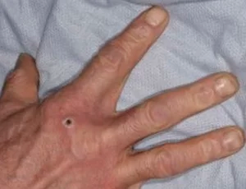
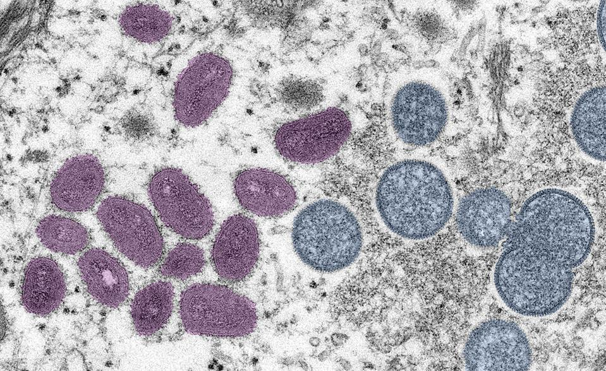

Slide 22
Thank you
Victor Alos Rullan, DMD, MPH, MS
Rullanv@co.delaware.pa.us
Tel & Fax 484-763-3113

